Slide 1

BIOS SPHERE // VANCOUVER · SCIENCE WORLD
SLIDE 01 OF 12 // BIOSSPHERE.ASHAYA.XYZ
LIVE AGENT BUILD · BUSINESS PROBLEM DEFINED
BUILD BIGGER,
BUILD MORE.
From synthetic eval data and mimic operators to token routing and recursive self-improvement.
ASHAYA SHARMA
space · live agent build
BIOS SPHERE // 2026
BIOS SPHERE // VANCOUVER · SCIENCE WORLD | BUILD BIGGER, BUILD MORE.
PAGE 01 / 12

Slide 2
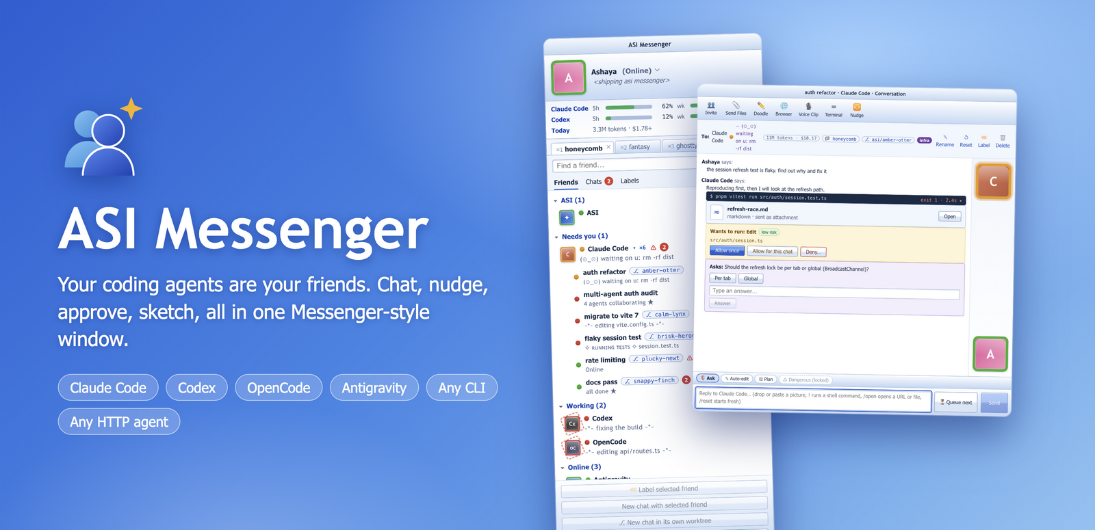

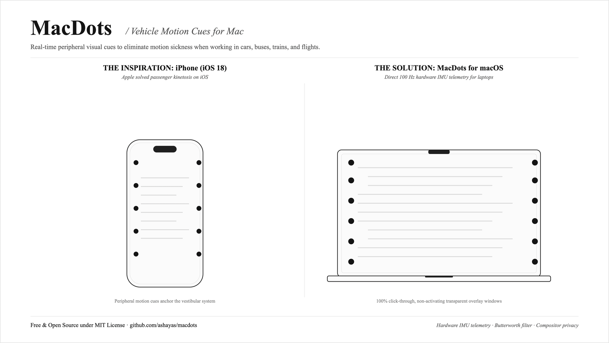
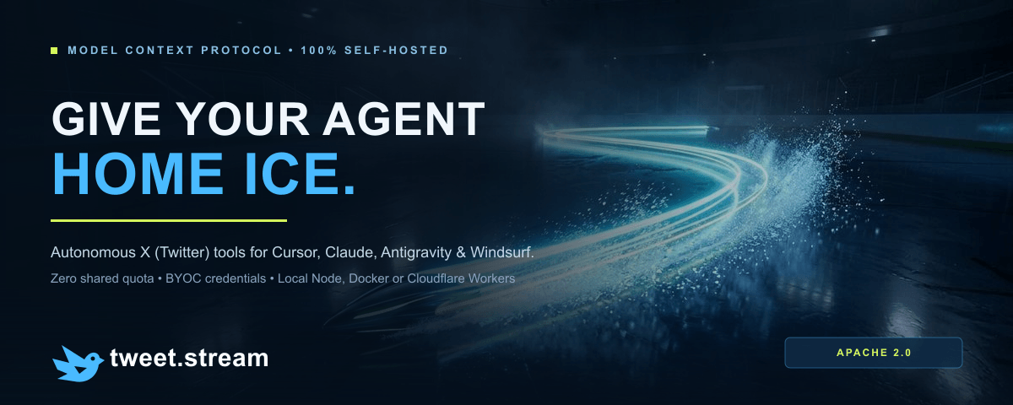
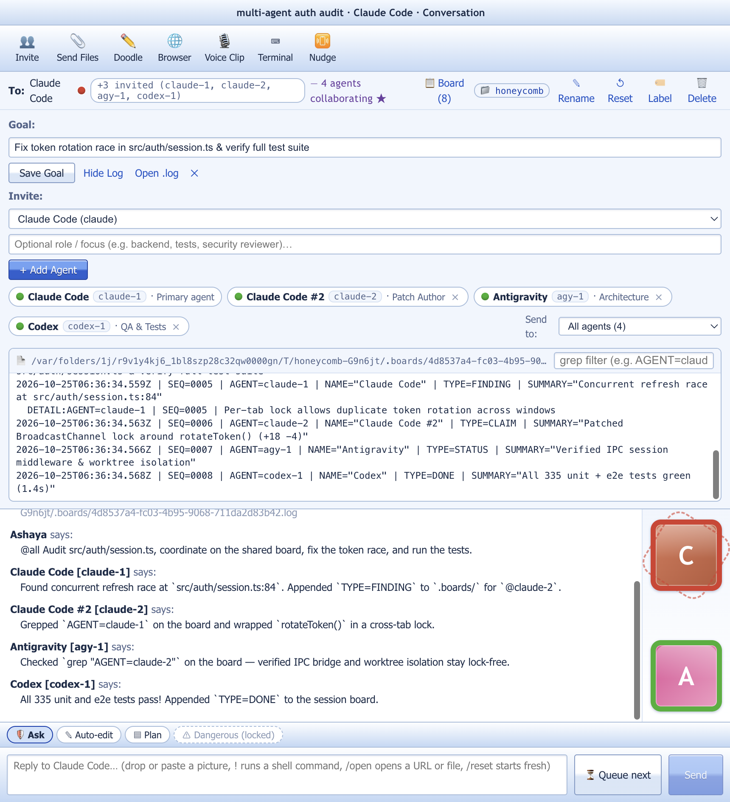
CHAPTER 01 // FIELD ARCHIVE · GITHUB.COM/ASHAYAS
SLIDE 02 OF 12 // BIOSSPHERE.ASHAYA.XYZ
01 · PAST MONTH OF BUILDS
“I’VE CLANKED OUT
A LOT OF RANDOM
STUFF.”
macOS agent buddy lists, 100Hz MEMS motion cues, Rust Workers, and local MCP bridges.
ASHAYAS/ASIMESSENGER
ASHAYAS/WHATCHUREADING
MSN-style macOS buddy list for CLI agents
Reading tracker · Rust Worker + D1
KEY POINT // AXIOM 01
VOLUME CREATES INTUITION.
Shipping fast exposes the core anatomy: start with data, mimic exemplars, route tokens, and recurse.
ASHAYAS/MACDOTS
ASHAYAS/TWEETSTREAM
MULTI-AGENT BOARD
100Hz Apple Silicon MEMS cues
Self-hosted X API & MCP Server
Collaborative sessions + Ghostty+
BIOS SPHERE // VANCOUVER · SCIENCE WORLD | BUILD BIGGER, BUILD MORE.
PAGE 02 / 12

Slide 3
CHAPTER 02 // ANATOMY OF AN AGENT BUILD · PART I
SLIDE 03 OF 12 // BIOSSPHERE.ASHAYA.XYZ
START WITH DATA. IF IT DOESN’T EXIST, CREATE IT.
The business problem is defined. Step one is building the dataset and eval set.
01 // DAY 0 BOOTSTRAP
02 // WATCH OUT
03 // FINAL STAGE
MODELS CREATE SYNTHETIC DATA
SYNTHETIC DATA PITFALLS
PIPE IN REAL DATA
Have frontier models generate realistic inputs, edge cases, and grading rubrics on Day 0.
[!] Mode Collapse: Inputs are too clean and polite.
[!] Self-Bias: Models overfit to their own phrasing.
[!] Blind Spots: Misses real production timeouts and weird state.
Start with synthetic data now. Replace it with real production usage traces at the final stage.
agent.synthesize_eval_cases(count=250, personas=['adversarial', 'noisy'])
WARNING // SYNTHETIC PASS != PRODUCTION READY
SYNTHETIC BUILDS THE TRACKS. REAL DATA DRIVES THE TRAIN.
BIOS SPHERE // VANCOUVER · SCIENCE WORLD | BUILD BIGGER, BUILD MORE.
PAGE 03 / 12

Slide 4
CHAPTER 03 // ANATOMY OF AN AGENT BUILD · PART II
SLIDE 04 OF 12 // BIOSSPHERE.ASHAYA.XYZ
HARNESS GOALS: MODELS AS MIMIC OPERATORS
Let the model do most of the work. Give it tools and point it at something that works well.
DEFINITION // MIMIC OPERATOR
GOAL 01 // AUTONOMY
LET THE MODEL DO THE WORK
MODELS ARE NATURAL MIMIC OPERATORS.
Give it raw tools and let it iterate in its native loop.
Instead of writing brittle rules, point the model at a working reference repo, handler, or golden trace to mimic.
GOAL 02 // EXEMPLARS
POINT AT WHAT WORKS
One golden example beats pages of negative constraints.
MIMIC SETUP:
01 // Point at a gold-standard exemplar
02 // Give full tool access (shell, files, search)
03 // Grade the outcome against the Eval Set
GOAL 03 // LOCKED
EVAL SET + PROCESS READY
With the Eval Set and Agent Process locked, we optimize deployment.
BIOS SPHERE // VANCOUVER · SCIENCE WORLD | BUILD BIGGER, BUILD MORE.
PAGE 04 / 12

Slide 5
CHAPTER 04 // ANATOMY OF AN AGENT BUILD · PART III
SLIDE 05 OF 12 // BIOSSPHERE.ASHAYA.XYZ
SAVING TOKENS: DIFFICULTY JUDGES & SUBAGENTS
Judge task difficulty upfront, use heavy models sparingly, and spin up subagents on demand.
01 // DIFFICULTY JUDGE
02 // SPARING USAGE
03 // SUBAGENTS
JUDGE TASK DIFFICULTY
USE MODELS SPARINGLY
SPIN UP SUBAGENTS
Score task complexity upfront and offload to the matching model tier.
Reserve frontier reasoning for hard synthesis. Route lookups and parsing to smaller models.
Spawn isolated subagents to finish subtasks and return only distilled results.
easy -> fast_flash_model
medium -> standard_worker
hard -> frontier_reasoner
60 TO 80% TOKEN SAVINGS.
ZERO DROP IN QUALITY.
spawn_subagent(
task=subtask,
model=judge.route(subtask)
)
BIOS SPHERE // VANCOUVER · SCIENCE WORLD | BUILD BIGGER, BUILD MORE.
PAGE 05 / 12

Slide 6
CHAPTER 05 // ANATOMY OF AN AGENT BUILD · PART IV
SLIDE 06 OF 12 // BIOSSPHERE.ASHAYA.XYZ
RECURSIVE SELF-IMPROVEMENT VIA RECURSE.PY
All recursiveness runs directly inside the coding agents.
PHASE 01 // RANDOM RUNS
EXECUTABLE // RECURSE.PY (IN CODING AGENT)
RUN RANDOM EPISODES
Trigger random runs on the agent to surface edge cases and failure modes.
# recurse.py (runs inside coding agent)
for run in random_runs(agent_harness):
score = eval_harness.grade(run)
if score.is_liked or score.is_disliked:
eval_harness.add(run, score)
coding_agent.patch(
target=agent_harness,
verify_against=eval_harness
)
PHASE 02 // EVAL HARNESS
ADD LIKES & DISLIKES TO EVALS
Every liked or disliked run automatically appends to the Eval Harness.
PHASE 03 // COUPLED LOOP
AGENT HARNESS -> EVAL HARNESS
KEY INSIGHT // The coding agent inspects traces and patches the harness against the growing eval set.
The coding agent edits the Agent Harness while pointing directly at the Eval Harness.
BIOS SPHERE // VANCOUVER · SCIENCE WORLD | BUILD BIGGER, BUILD MORE.
PAGE 06 / 12

Slide 7
CHAPTER 06 // DIAGNOSTIC REPORT · FIELD MISTAKES
SLIDE 07 OF 12 // BIOSSPHERE.ASHAYA.XYZ
MISTAKES WHEN BUILDING AGENTS
Three traps: over-instructing frontier models, missing review gates, and forgetting classical ML.
01
Heavy micro-steering nerfs frontier models. Drop low-level rules and steer at the high-level business process.
INSTRUCTING TOO MUCH
OVER-STEERING NERFS THE MODEL
02
Give the agent a clear split: flag high-risk actions for human review, and mark routine actions non-reviewable.
NO REVIEW CONTROL FLOW
HUMAN-REVIEW VS. NON-REVIEWABLE
03
Don't use a huge LLM for every step. Have the coding agent train a fast classifier, reranker, or small model.
NEGLECTING CLASSICAL ML
LET THE AGENT BUILD CLASSIFIERS
BIOS SPHERE // VANCOUVER · SCIENCE WORLD | BUILD BIGGER, BUILD MORE.
PAGE 07 / 12

Slide 8
CHAPTER 07 // PROMPTING, PLANS & CODE TRADEOFFS
SLIDE 08 OF 12 // BIOSSPHERE.ASHAYA.XYZ
PROMPTING STILL MATTERS. SO DOES READING THE PLAN.
The agent will figure it out eventually, but crisp prompts save tokens and code review catches misaligned tradeoffs.
01 // PROMPTING SAVES TOKENS
02 // DO YOU READ THE CODE?
EXACT REFERENCES CUT SEARCH TOKENS
NOT INCORRECT. JUST MISALIGNED.
The agent can solve vague prompts, but it burns thousands of tokens exploring dead ends first.
We read less boilerplate now. Agent code is rarely broken, so syntax isn't the bottleneck.
HIGH-SIGNAL TERMS:
Using exact words like "fault-resistant" or naming specific files turns 25 search turns into 1.
-> Once anchored, read the plan.
CHECK THE TRADEOFFS:
Agents silently pick fundamental tradeoffs (stateful vs. stateless, schema coupling, caching). Read the plan and core code to verify alignment.
BIOS SPHERE // VANCOUVER · SCIENCE WORLD | BUILD BIGGER, BUILD MORE.
PAGE 08 / 12

Slide 9
CHAPTER 08 // DUAL COMPOUNDING LOOPS
SLIDE 09 OF 12 // BIOSSPHERE.ASHAYA.XYZ
TWO SELF-IMPROVING LOOPS: .AGENTIC/ & .MISTAKES/
One loop improves the runtime agent. A second loop improves the harness building it.
LOOP 01 // RUNTIME AGENT
LOOP 02 // BUILDER HARNESS
FUEL // REAL DATA
.AGENTIC/ WORK FOLDER
.MISTAKES/ MEMORY FOLDER
PIPE IN PRODUCTION TRACES
Self-improving loop for the deployed agent: stores plans, mimic exemplars, evals, and recurse.py runs.
Self-improving loop for the builder harness: logs past mistakes and bad tradeoffs so the coding agent never repeats them.
Record real production usage and feed traces back into both folders continuously.
.agentic/
├── eval_harness.jsonl
├── mimic_exemplars/
└── recurse.py
.mistakes/
├── over-steering.md
├── schema-tradeoffs.md
└── sandbox-leaks.md
REAL USAGE DATA -> UPGRADES BOTH .AGENTIC/ AND .MISTAKES/.
BIOS SPHERE // VANCOUVER · SCIENCE WORLD | BUILD BIGGER, BUILD MORE.
PAGE 09 / 12

Slide 10
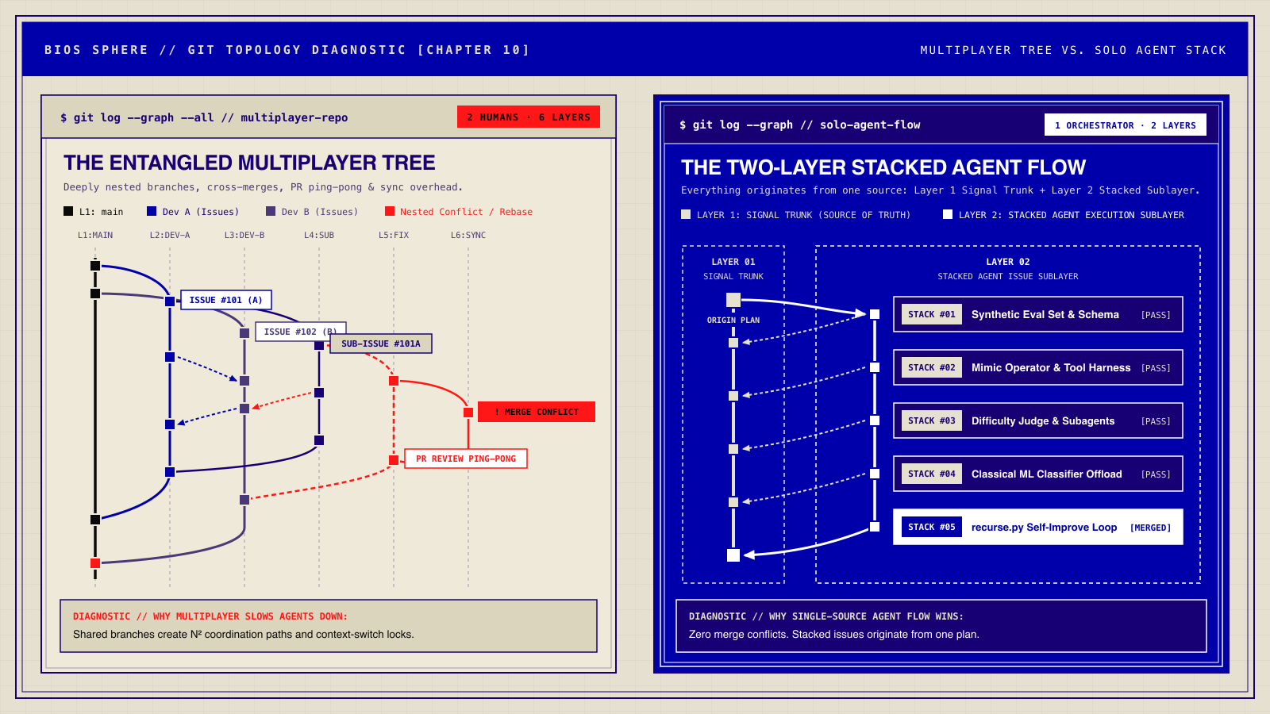
CHAPTER 09 // WORKFLOW TOPOLOGY: MULTIPLAYER VS. STACKED AGENT FLOW
SLIDE 10 OF 12 // BIOSSPHERE.ASHAYA.XYZ
BIOS SPHERE // VANCOUVER · SCIENCE WORLD | BUILD BIGGER, BUILD MORE.
PAGE 10 / 12

Slide 11
CHAPTER 10 // SANDBOX VERIFICATION & HARNESS RIGOR
SLIDE 11 OF 12 // BIOSSPHERE.ASHAYA.XYZ
STRESS-TESTED SANDBOXES & FEEDBACK GATES
Your agent loop is only as trustworthy as its sandbox. Stress-test isolation, types, and local runtime parity.
GATE 01 // ISOLATION
GATE 02 // TYPES
GATE 03 // PARITY
GATE 04 // LOGS
CLEAN WORKTREES
FAST COMPILER
LOCAL RUNTIME
GREPABLE LOGS
Fresh worktree per task. Zero shared state.
cargo check & tsc catch drift in milliseconds.
Real local D1 & Worker bindings under load.
Structured logs for instant agent self-triage.
UNVERIFIED SANDBOX // FALSE POSITIVES
STRESS-TESTED SANDBOX // GROUND TRUTH
PHANTOM GREEN BUILDS
REAL SELF-CORRECTION
Mocked DBs and dirty state trick recurse.py into optimizing against fake passes.
Concurrency tests and real bindings feed clean failure traces into .mistakes/ and the Eval Harness.
BIOS SPHERE // VANCOUVER · SCIENCE WORLD | BUILD BIGGER, BUILD MORE.
PAGE 11 / 12

Slide 12

EPILOGUE // THE COMPLETE AGENTIC SYSTEM · CONNECT
SLIDE 12 OF 12 // BIOSSPHERE.ASHAYA.XYZ
BUILD BIGGER, BUILD MORE.
CONNECT ON X / TWITTER
Start with data, mimic exemplars, route tokens, and run two self-improving loops.
PILLAR 01 // DATA + MIMIC
PILLAR 02 // ROUTING
DATA & MIMIC OPERATORS
JUDGES, SUBAGENTS & ML
Synthesize Day-0 evals, point at working exemplars, and graduate to real traces.
Score task difficulty upfront, spawn subagents, and let agents train small classifiers.
PILLAR 03 // STEERING
PILLAR 04 // 2 LOOPS
PROCESS & PLAN REVIEW
.AGENTIC/ + .MISTAKES/
x.com/ashaya
Steer high-level process, split reviewable vs. auto flows, and check plan tradeoffs.
Run recurse.py in the agent (Loop 1) and log harness lessons in .mistakes/ (Loop 2).
SCAN QR CODE TO FOLLOW
open x.com/ashaya ↗
ASHAYA SHARMA // X.COM/ASHAYA · BIOSSPHERE.ASHAYA.XYZ
BIOS SPHERE // VANCOUVER · SCIENCE WORLD | BUILD BIGGER, BUILD MORE.
PAGE 12 / 12

